Slide 1
Revised Ab-Peptide Array Binding Kinetics Model
New / Revised Terms
Revised Ab-Peptide Binding Model Incorporates Two-State Binding Kinetics
State 1: Initial Ab + Peptide Encounter (Diffusion Limited Kinetics)
State 2: AbPep* Low-Affinity Complex Reorganization to Induced Fit High-Affinity Configuration (Interaction Specific Kinetics)
Two-State Binding Model has been Reported for 10+ years with Ab-Peptide binding Kinetics
Refs:
Galanti, M. et al. Conformation-controlled binding kinetics of antibodies. Sci. Rep. 6, 18976; doi: 10.1038/srep18976 (2016)
James LC & Tawfik DS, Structure and kinetics of a transient antibody binding intermediate reveal a kinetic discrimination mechanism in antigen recognition. PNAS 102:36 (2005)
Baggio R, et.al. Induced Fit of an Epitope Peptide to a Monoclonal Antibody Probed with a Novel Parallel Surface Plasmon Resonance Assay. JBC, 280:6 (2005)
Experimental Data from Array Binding Time Studies Supports Two-State Binding Model:
Longer Incubation time results in slower off rates
Revised Binding Model Equation
State 1:
Low-Affinity Encounter Complex
(Diffusion Limited Kinetics)
State 2:
High-Affinity Induced Fit Complex
(Interaction Specific Kinetics)

Slide 2
Revised Ab-Peptide Array Binding Kinetics Model
Biophysical/Chemical Interpretation of Terms
Diffusion
(Sample Composition)
(viscosity, detergent, blocking agent, etc.)
AbPep Interaction-Specific
On-rate
k₁on
k₂on
k₁off
k₂off
AbPep Interaction-Specific
Off-rate
Desorption
(Surface Properties)
(charge, density, hydrophilicity, etc.)

Slide 3
Revised Ab-Peptide Array Binding Kinetics Model
Revised Binding Model Equations
New / Revised Terms and Equations
Change in Unbound [Ab] vs. Time
Change in Unbound [Pep] vs. Time
Change in Low-Affinity Encounter Complex [AbPep*] vs. Time
Change in High-Affinity Induced Fit Complex [AbPep] vs. Time
Revised Model Parameters and Constants

Slide 4
VERSION 1.0 Revised Ab-Peptide Array Binding Kinetics Model with Simulation of Differential Equations
(VERY PRELIMINARY) Revised Mathematical Model is Better Simulating Experimentally Observed Bi-Modal Intensities
(VERY PRELIMINARY) Simulation:
Generate a Log-Normal Distribution Set Of On-Rates (k2on)
Fix k1on/off (diffusion) and k2off
Simulate AbPep Bound Concentration for X minutes for all On-Rates, in 0.5 sec increments
Aggregate the AbPep vs. Time Data for All On-Rates and Sort By Time Increment
Plot the Max [AbPep] Observed vs. Time
[AbPep] Fast Binders
[AbPep] Slow Binders
Revised Binding Model Equation
Simulation Binding Distribution
Very Sensitive to k2 values
(Ab-Peptide interaction specific on/off rates)
(VERY PRELIMINARY) Revised Model Needs a Lot of Work to Replicate Experimental Data.
May need to start with a multi-mode distribution of on-rates to simulate observed [AbPep] (i.e. Fluorescence) signal
[AbPep] vs. Time Should be Smoother than Current Simulation

Slide 5
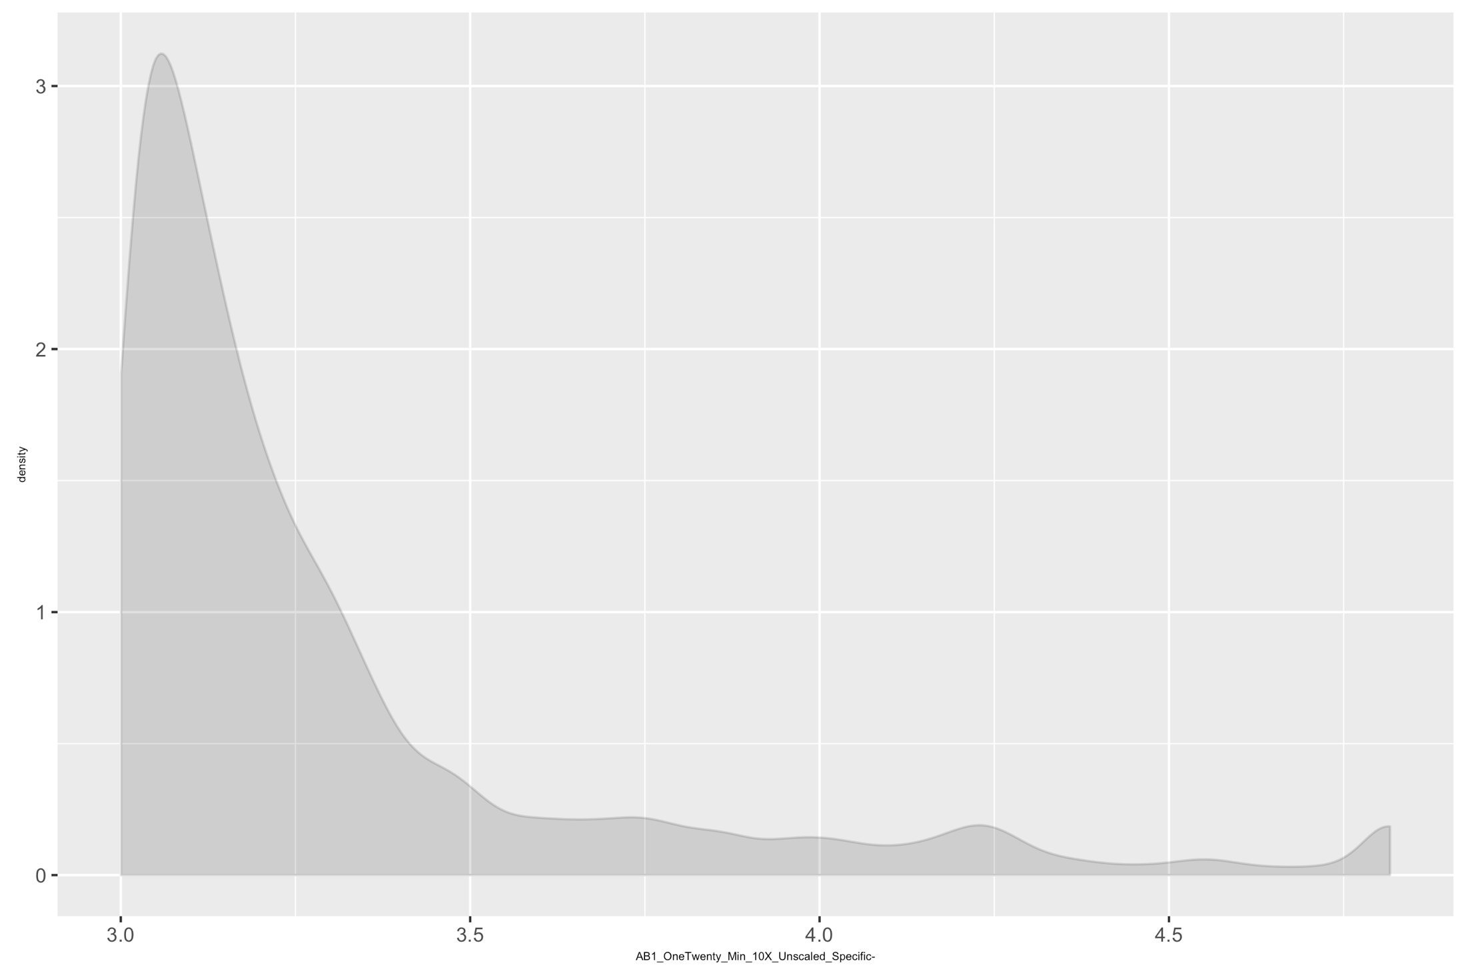
VERSION 2.0 Revised Ab-Peptide Array Binding Kinetics Model with Simulation of Differential Equations
VERSION 2.0 (VERY PRELIMINARY) Revised Mathematical Model is Better Simulating Experimentally Observed Bi-Modal Intensities
Version 2.0 (VERY PRELIMINARY) Simulation:
Generate a Bimodal Distribution Set Of Association Constants (K_{a}s)
Simulate AbPep Bound Concentration after 120 minute incubation using two-state binding model system of equations.
Input K_{a} Bimodal Distribution
Simulated [AbPep] Distribution
120 minute Incubation
Observed Distribution
120 minute Incubation
AbPep Intensity
K_{a}
[AbPep]

Slide 6
VERSION 2.1 Revised Ab-Peptide Array Binding Kinetics Model with Simulation of Differential Equations
VERSION 2.1 (Includes k2 off-rate distribution) Revised Mathematical Model is Better Simulating Experimentally Observed Bi-Modal Intensities
Version 2.0 (VERY PRELIMINARY) Simulation:
Generate a Bimodal Distribution Set Of Association Constants (K_{a}s)
Simulate AbPep Bound Concentration after 120 minute incubation using two-state binding model system of equations.
Input k₂on Bimodal (Normal) Distribution
Simulated [AbPep] Distribution
120 minute Incubation
Observed Distribution
120 minute Incubation
k₂on
Input k₂off Bimodal (LogNorm) Distribution
AbPep Intensity
k₂off
[AbPep]

Slide 7
VERSION 2.1 Simulating Sample-Specific Binding
Chagas Sample 6041, Specific Binders (>= 2-fold 6041 vs. all Chagas panel)
Input k₂on Bimodal (Normal) Distribution
k₂on distribution needed to be shifted towards faster
Interaction specific induced fit conformation change to simulate sample-specific binding distribution.
Simulated 6041 Specific Binding Distribution
120 min incubation, 10X Wash
Experimental 6041 Specific Binding Distribution
120 min incubation, 10X Wash
k₂on
Input k₂off Bimodal (LogNorm) Distribution
k₂off distribution needed to be shifted slightly towards slower interaction specific dissociation to simulate sample-specific binding distribution.
[AbPep]
AbPep Intensity
k₂off

Slide 8
VERSION 2.1 Simulating Sample-Specific Binding
Chagas Sample 6051, Specific Binders (>= 2-fold 6051 vs. all Chagas panel)
Input k₂on Bimodal (Normal) Distribution
k₂on distribution needed to be shifted towards faster
Interaction specific induced fit conformation change to simulate sample-specific binding distribution.
Simulated 6051 Specific Binding Distribution
120 min incubation, 10X Wash
Experimental 6051 Specific Binding Distribution
120 min incubation, 10X Wash
k₂on
Input k₂off Bimodal (LogNorm) Distribution
k₂off distribution needed to be shifted slightly towards slower interaction specific dissociation to simulate sample-specific binding distribution.
[AbPep]
AbPep Intensity
k₂off

